Slide 1

Internship Mid-Sem Review
Organization Name : Whirlpool Corporation (GTEC)
Domain : Data Analytics (Informatica Developer)
Name - Om Parag Butala
Class - CS-C-3 BTech
PRN - 22120149
Guide : Prof. Namrata Wasatkar
Industry Manager : Nitin Phuke
Industry Mentor : Mohit Shrivastava

Slide 2
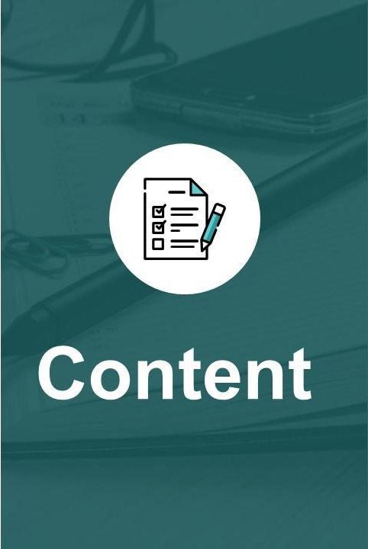
About company
Introduction
Problem statement
Literature review
Clarity about the objectives of internship activity
Internship planning
Tools

Slide 3

Whirlpool corporation is a multinational manufacturer company and marketer of home appliances. Headquarters in the united states, its known for producing a wide range of products like refrigerators, washing machines and ovens. With a global presence, whirlpool operates in more than 170 countries. The company focuses on innovation, energy efficiency and consumer convenience, making it a prominent player in the appliance industry. Over the years, whirlpool has built a reputation for quality and reliability in it’s products.

Slide 4
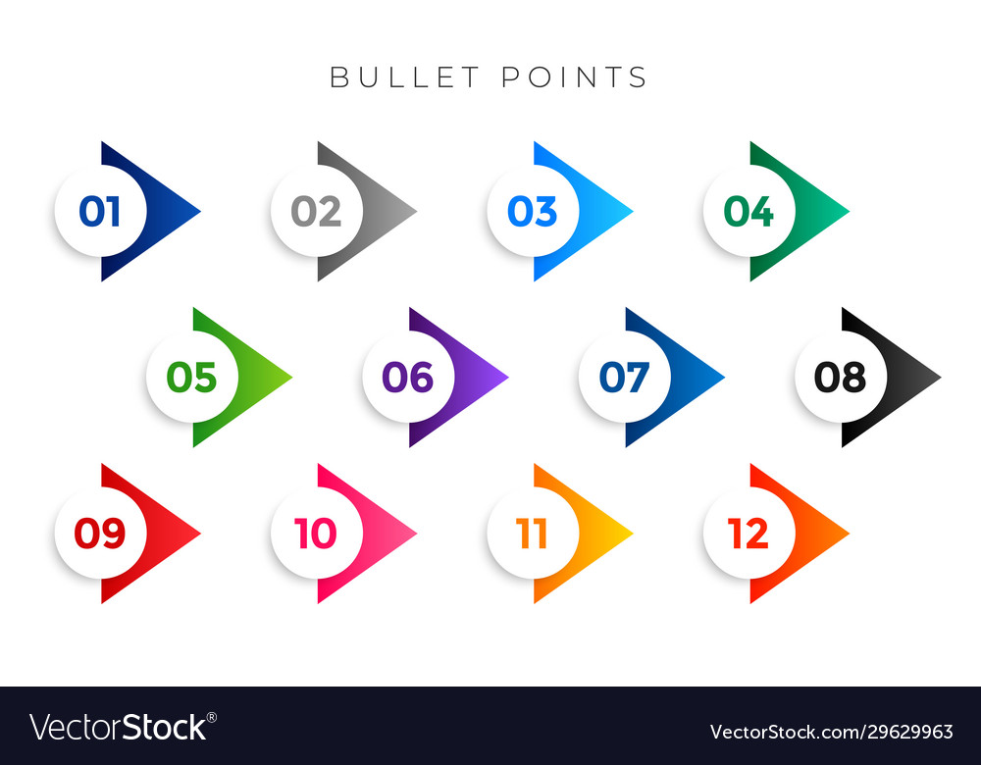


Introduction
This internship includes training as well as a project in which I have to perform ETL(Extract, Transform, load) Operation on real time data about the company as per the requirement of client using Informatica PowerCenter and IICS tool.

Slide 5

Objectives
To understand SQL (Advanced).
Understanding Data Warehousing, ETL.
Mastering the Informatica ETL tool.
Data Integration of real world data.

Slide 6

Problem statement
To develop the mapping workflows as per the technical requirements from different stakeholders related to Sales, Promotions, Products, Orders, Service etc. and supporting the same. Also, monitoring and troubleshooting existing tasks when abended/suspended. Also learning the admin side activities (Repository Management, Server Management, User Management) for ETL Informatica.

Slide 7

Literature Review
Informatica is introduced as a software development company in the market. It provides a complete data integration solution and data management system. It launched multiple products that mainly focused on data integration.
Informatica is used to extracting required data form operation all systems and transforms the same data on its server and load it to the data warehouse.

Slide 8
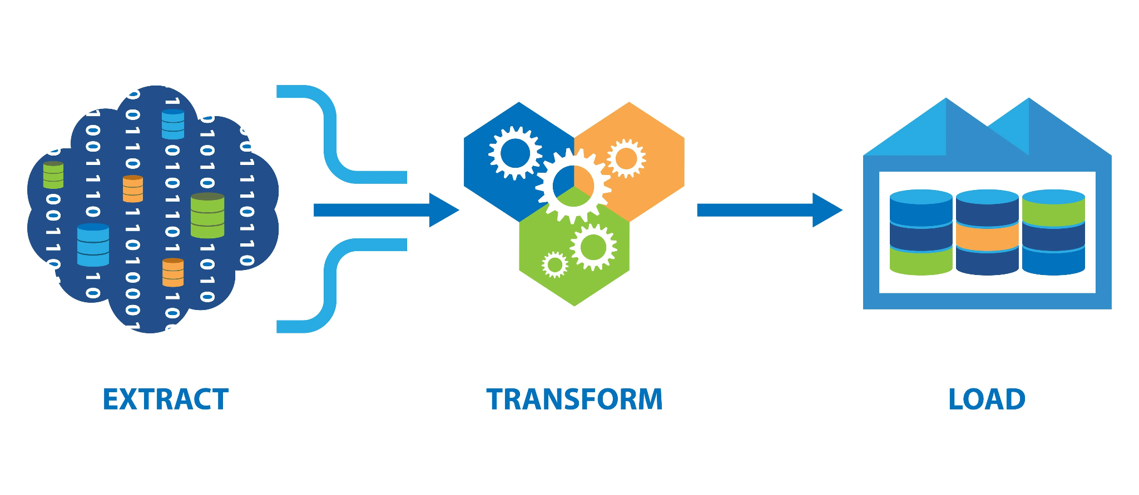
ETL Process
Extracting required data form operation all systems
Transforms the same data on its server
Load it to the data warehouse.

Slide 9
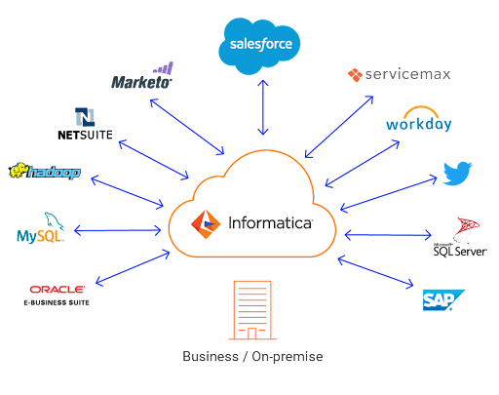
Internship Planning
Advanced SQL
Data warehousing
Informatica PowerCenter
Informatica Intelligent Cloud Services(IICS)
Working on real time Data

Slide 10
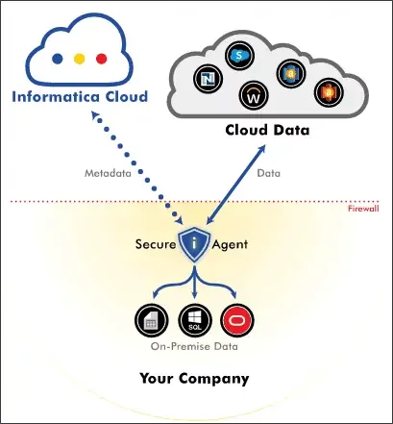
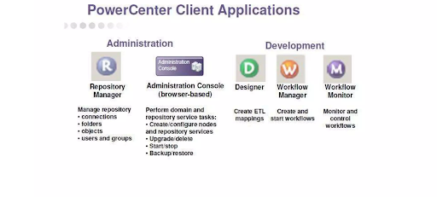
Tools used for ETL
Informatica PowerCenter.
Informatica Intelligent Cloud Services (IICS).

Slide 11


